Slide 1
Microsoft Remote Build Execution Dev Speedup with Non-Hermetic Build Engines
AnyBuild
Erik Mavrinac
Microsoft One Engineering System
October 1, 2019

Slide 2
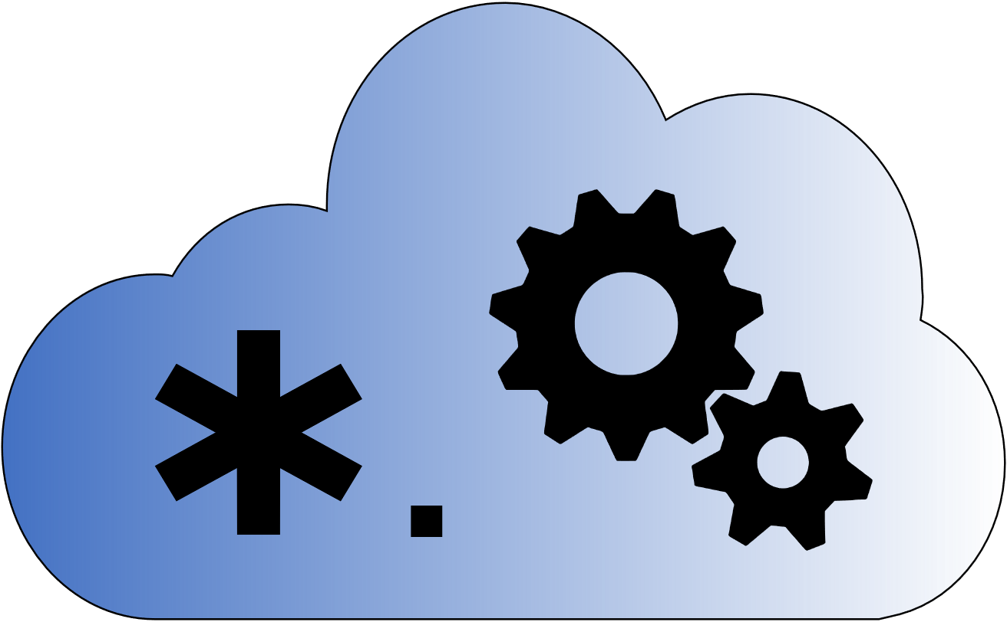
Talk Overview
Background, motivation & challenges
The AnyBuild approach
First results
Internals
Roadmap

Slide 3
Microsoft Cloud Based Build
CloudBuild and QuickBuild – 2012
Allow distributing MSBuild and the 1989 NT nmake build system
E.g.: 10-hour retail builds ➔ ~1 hour, 6-hour debug builds ➔ ~16 minutes
Caching came later to make 1-minute builds common
Build Accelerator (BuildXL) – 2014
Cache-first, based on Bazel pattern of complete input, output specs
Windows and Office first – the largest codebases in the company at 250-500 GB
Open source in early 2019, MSBuild support in 2018, converging with QuickBuild slowly
CloudBuild builds thousands of repos from a few megs to ½ TB
400K builds/week on >35,000 physical machines

Slide 4
The Basic Premise of Remote Execution
RE extends a build machine’s capabilities
More CPU cores (and GPUs if that’s your need)
More memory
Most importantly: More I/O buses and disks
Most conventional build tools are I/O-heavy
Has costs in terms of cloud compute, latency and overhead per remoted task moving data back and forth
Trade compute cost for overall developer time and productivity
Example from one 75-person internal team: Reduction by half of build time on longer desktop builds can save 9500 hours/month
Plus reduces or delays the need for devs to spend time optimizing build logic

Slide 5
Challenges for Remote Execution (At Microsoft and In General)

Slide 6
The Agent Tool Installation Problem
Chasing the latest that devs are using is not fun
What about this SDK? This tool? This package? This admin-installed product (Docker)?
VM/container image management is a chore
Patching (of course)
Union of all tools needed by all (devs X repos)
Example: Azure DevOps Pipelines has an image line for Windows Server 2019 that is constantly updating with new Docker, Visual Studio, MSBuild, NodeJS, Python 2, Python 3, Windows SDK, …
Have something custom? You get to manage your own image line (booyah!)

Slide 7
The Build Language Problem (Not Just for MSFT)
We can’t bring everyone to Bazel
Legacy-legacy-legacy: Millions of lines of build code, thousands of repos, 100K’s devs
Changing build language is not normal business need – dev team speedup usually not enough vs. customer-facing features and fixes for +revenue/-costs
This is less true the more massive the codebase and the more pain the devs feel
So mid-sized repos’ devs feel it the most
Changing build language introduces build, test, deployment bugs that can be time consuming to figure out
Dev retraining to a new build language is a significant human and org cost
We need to bring remote exec to where the devs are
I would use Bazel in a new startup – knowing what happens when your code grows over time
Notes:
Said a large team circa 2013: We’ll take 2000 devs for a month and convert 125,000 build specs to a new language. Actual number converted: 0. Sanity prevailed.

Slide 8
The Build Engine Nondeterminism Problem
Example: Gulp – build engine as JS code execution
Good luck modeling all the inputs and outputs to get hermeticity!
Example: MSBuild – underspecified, ProjectReference not even a top-level graph concept yet
Like Make: filesystem datetimes as a state database, plus in-memory properties
MSBuild Project Graph feature underway to improve this
Chasing these engines to wrap caching and distribution around them is expensive
Over 8 years chasing MSBuild so far in QuickBuild
Creating inputs/outputs knowledge is hard, always breakable by the next thing you don’t understand

Slide 9
The Build Tool Path Reliance Problem
The conversion of tools to the Reproducible Builds pattern is far from complete
GUIDs and timestamps are only part of the problem, substantially solved with the right newer tool flags
If teams decide to use the flags… they are off by default
Some outputs end up with absolute paths in them that affect downstream debugging or outputs

Slide 10
The Enlistment Problem
In QuickBuild, BuildXL builds we mostly use real enlistments
Virtual Filesystem for Git (fka GVFS) for Windows repo (currently)
Pull/update/refresh packages before every build
Every build machine in a session synced to the same commit and packages
Same pre-loaded view of the filesystem
Maintaining 100K’s of enlistments to avoid up to 4 hours of re-pulling per build is one of CloudBuild’s value adds
Aided by physical machines, full machine reimaging is a low %/day
Maintaining enlistments on non-durable VMs is harder
And if you have lots of customers that’s a lot of disk space to maintain

Slide 11
The Batch Build ProblemPattern
CloudBuild is a massive batch build system
Rolling builds, PR iteration builds, on-demand buddy builds are focus
Dev machines are fat clients typically
No strong virtualization story outside of VFS/GVFS, not for lack of trying
Changes to “leaf” components leverage cache from datacenter
Making changes to core components? Rebuild all dependents, no help from batch builds
Good luck being the dev upgrading packages or making a large refactor!
We use lots of buddy builds in the datacenter when doing this
Missing: Help devs running fat client toolsets

Slide 12
The AnyBuild Approach
Notes:
What if…
- We let an existing build engine just do whatever it wants to do locally with filesystem timestamp or hash based incrementality etc. (build language and build tool nondeterminism problems)
- We watch what it decides to do and remote things selectively
- And we can remote on minimal agents that don’t need to have enlistments, packages, or Ʃ(tools) installed (agent tool and enlistment problems)
- And we ensure that tools that rely on absolute paths still work seamlessly (path reliance problem)
- And we run on dev desktops, letting the cloud extend the dev machine (augmenting batch build pattern in dev workflow)

Slide 13
Microsoft AnyBuild Remote Execution
Client wraps existing engine, hooks process creation
Choose to remote based on current machine state, policies, historical knowledge, agent availability
Client and Agent CAS are central to system similar to Bazel RE
Same upload/download gRPC protocol, see later slide
Agents are minimal Win10 1903 images with no toolsets installed
Filesystem virtualization: Tools see client paths, no difference from running at client
New: Agent can reach back to client to pull missing directories and files dynamically, non-hermetic predictions are slower instead of failing

Slide 14




High Level How-Does-It-Work?
Dev Desktop/Laptop
Remote Build Execution Service
Remote Build Execution client
Lives within regular build command
Integrated update mechanism
Agent Coordinator intelligently allocates VMs (number + size) to optimize build time & distributes build tasks among VMs
3. Copy delta of files to build in cloud
VMs run the required build tasks in parallel, leveraging peer-to-peer CAS
1. Dev initiates local build command (the same they normally use)
2. Remote Build Execution Client analyzes which build tasks to offload
4. Copy offloaded build outputs
CAS manages the cache of previous build inputs and outputs
5. Merge build results (re-use from cache when possible)
If service is unavailable, local build works transparently

Slide 15
First Results

Slide 16
Beefy desktop – 8 minutes saved of 18.5

Slide 17
Laptop – 36 of 70 minutes saved

Slide 18
Details
6/12 core: Desktop dev machine, 64GB mem, M.2 SSD
2/4 core: Laptop, 16GB mem, SSD
Internal C++-heavy mid-sized repo
500 MSBuild projects, 300 vcxproj (C++)
25 build agents plus service coordinator VMs in shared 96-core team deployment with from 2 to 16 cores per agent
Azure D2 v2 generic compute VMs preferred for agents
v3 would be less expensive per core but less capable, temp drive is too small on 2-core SKU
Deployment would cost ~$2K/month in VM time running only during business hours (50 hours/week) assuming full retail metered VM billing
cl.exe (compiler) remoting only (like Goma)
Debug full build with no LTCG linking
MSBuild parallelism settings at +50% meaning /m:18 for the 6/12 core and /m:6 for the 2/4 core
AnyBuild MinParallelism=4 to remote only larger compilations (4+ cpp files)

Slide 19
Internals

Slide 20

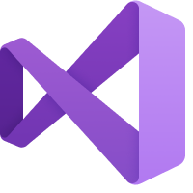

AnyBuild Agent
Visual Studio
Compiler
AnyBuild Sandbox
MSBuild
AnyBuild Agent
robocopy
VSTest
Remote Shim
exe
VSTest
Remote Shim
exe
Compiler
Local Disk
Notes:
Narrator: Let’s say you’re using Visual Studio for your project. <tap>
You’ve installed Microsoft AnyBuild and you hit F6 to build and test. <tap>
You are using MSBuild as your build language. <tap>
We wrap MSBuild in an AnyBuild execution sandbox <tap> to intercept MSBuild’s actions. MSBuild proceeds to run all of its usual tool chains<tap>, including incrementalism derived from timestamps and other information on disk.
Let’s say MSBuild decides to run an external process <tap> like a compiler.
AnyBuild sees this action and inserts <tap> a proxy process. The command line, environment, and current working directory are <tap> passed to AnyBuild.
AnyBuild predicts file and directory inputs and determines that this process is worth remoting. <tap> AnyBuild gets an available build agent from the cloud, and <tap> tells it to run your process. AnyBuild caching technology uses petabytes of cloud storage to cache every source code file, every package, and every app that your repo uses, so that we only upload the very latest files you changed on your dev machine.
<tap> We cache the outputs in the cloud, then pull them back to your dev machine, <tap> and place them on your hard drive just as though the results were run locally. Then we release MSBuild to keep processing. <tap>
When an Azure AnyBuild agent is not available, or for processes that <tap> require far more I/O than CPU power, AnyBuild can <tap> run the process locally.

Slide 21
ProjFS, BindFlt Win10 Drivers and BuildXL Sandboxing
ProjFS: Incremental filesystem rendering with placeholders
Underpins Virtual Filesystem for Git (fka GVFS) since Win10 1607 (RS1) release
Dir+file callbacks (vs. FUSE full virtualization w/o local disk)
Used to virtualize all client drive letters and paths on agent
Dir, file callbacks resolved from CAS or paused to get from client if nothing from predictions
BindFlt (Win10 1903/RS6): Selective remapping of directories
Snip out the virtualization working directory on agent, ensure calls into WinAPIs on agent
Compare to chroot
Run command under BuildXL sandbox that watches filesystem API calls to find build inputs and outputs
Compare to dtrace
See Kristijan Semic’s talk in this Meetup for macOS sandbox

Slide 22
Azure Deployment Architecture
Agents are VMs, not containers
ProjFS, BindFlt need admin
Azure VM Scale Sets make for easy scale up/down
Agents are reused between commands but are team or org specific
AgentCoordinator service provides agent lists to clients within shared pool
Agents currently use direct IPs, clients move on if agents are busy
Intent is to move to a centralized service proxy like RE over time
CosmosDB, Redis, Blob Storage, KeyVault underlie these pieces

Slide 23
Remote Execution Protocol Usage
We are based on Bazel RE for low level currently, more as time allows
By service interface:
ByteStream: 95%
CAS: 80%
Capabilities: 0%
ActionCache: 0%
No datacenter or local caching yet, cut during early iterations, we let MSBuild incrementalism reign
Execution: 0%
Complicated: See next slide

Slide 24
Specialized Execution gRPC call
2-way server<->client
Stdout, stderr outputs are interleaved for higher fidelity output
Agent can reach back to client to get directory metadata, file hashes, file contents not predicted by client
This is how we handle nondeterminism and optimism failures in CAS
E.g. #include “..\inc\foo.h” not found in command prediction or other data will result in slowness but not failure
We can take specific misses and feed back to users in a UX if we know it’s something they need to add metadata about. “Your build would be faster if you added <ClInclude>..\inc\foo.h</ClInclude> to bar.vcxproj”

Slide 25
Example of a Missing Header Prediction
From command line prediction c:\repo\bar\bar.h is not predictable. We don’t predict c:\repo\bar or anything in it; the agent does not get dir metadata or files.
When running on the agent, cl.exe will open that directory then read bar.h.
// foo.cpp in c:\repo\foo
// Command line: c:\bin\cl.exe foo.cpp
// (with cwd c:\repo\foo)
#include "..\bar\bar.h"
int main()
{
printf("Hello world!");
}
Notes:
We also scrape .vcxproj files for hints like <ClInclude> but let’s assume in this case that there is no hint.

Slide 26
AnyBuild Agent
Visual Studio
C:\bin\cl.exe foo.cpp (in c:\repo\foo)
// Loader: Load and run cl.exe
GetDir: D:\any\0\C\ - PREDICTED
GetDir: D:\any\0\C\bin - PREDICTED
GetFile: D:\any\0\C\bin\cl.exe - PREDICTED
GetFile: D:\any\0\C\bin\c1xx.dll - PREDICTED
AnyBuild Sandbox
MSBuild
// cl.exe: Load foo.cpp
UseExisting: D:\any\0\C
GetDir: D:\any\0\C\repo - PREDICTED
GetDir: D:\any\0\C\repo\foo - PREDICTED
GetFile: D:\any\0\C\repo\foo\foo.cpp - PRED.
// cl.exe: Load ..\bar\bar.h
UseExisting: D:\any\0\C\repo
GetDir: D:\any\0\C\repo\bar – NOT PREDICTED
GetDir(“C:\repo\bar“)
Local Disk
// cl.exe: Load ..\bar\bar.h
UseExisting: D:\any\0\C\repo
GetDir: D:\any\0\C\repo\bar – NOT PREDICTED
GetFile: D:\any\0\C\repo\bar\bar.h – NO HASH
GetHash("C:\repo\bar\bar.h")
Not in CAS? GetContent("C:\repo\bar\bar.h")

Slide 27
Content Addressable Store
Implementation uses the tiered local and peer-to-peer BuildXL cache system
No “backdrop” layer currently since we can always get files from client
gRPC between machines
Redis as replica tracking store
Layered metadata database state caches (“LLS”) in between
Client has a local CAS for build output caching
Only used for known-deterministic commands
Since we can call back to dynamic file retrieval from client, CAS can be best-effort optimistic within reason

Slide 28
Roadmap
Shipping internally to first customer in late October
BazelCon (Dec 2019) timeframe: First trivial Bazel build against Agent
Going fully open source in next few months: https://github.com/Microsoft/AnyBuild
Might propose 2-way agent contract as an RE protocol extension
Possible integrations next year: BuildXL, QuickBuild, Azure DevOps Pipelines

Slide 29
AnyBuild: https://github.com/Microsoft/AnyBuild
BuildXL: https://github.com/Microsoft/BuildXL
MSBuild: https://github.com/Microsoft/MSBuild

Slide 30


